Slide 1
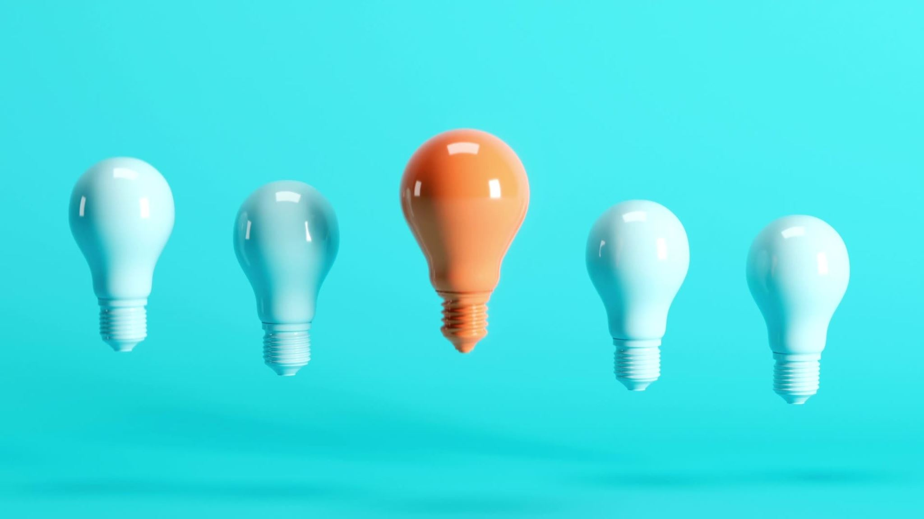
Make efficient feel power

Slide 2
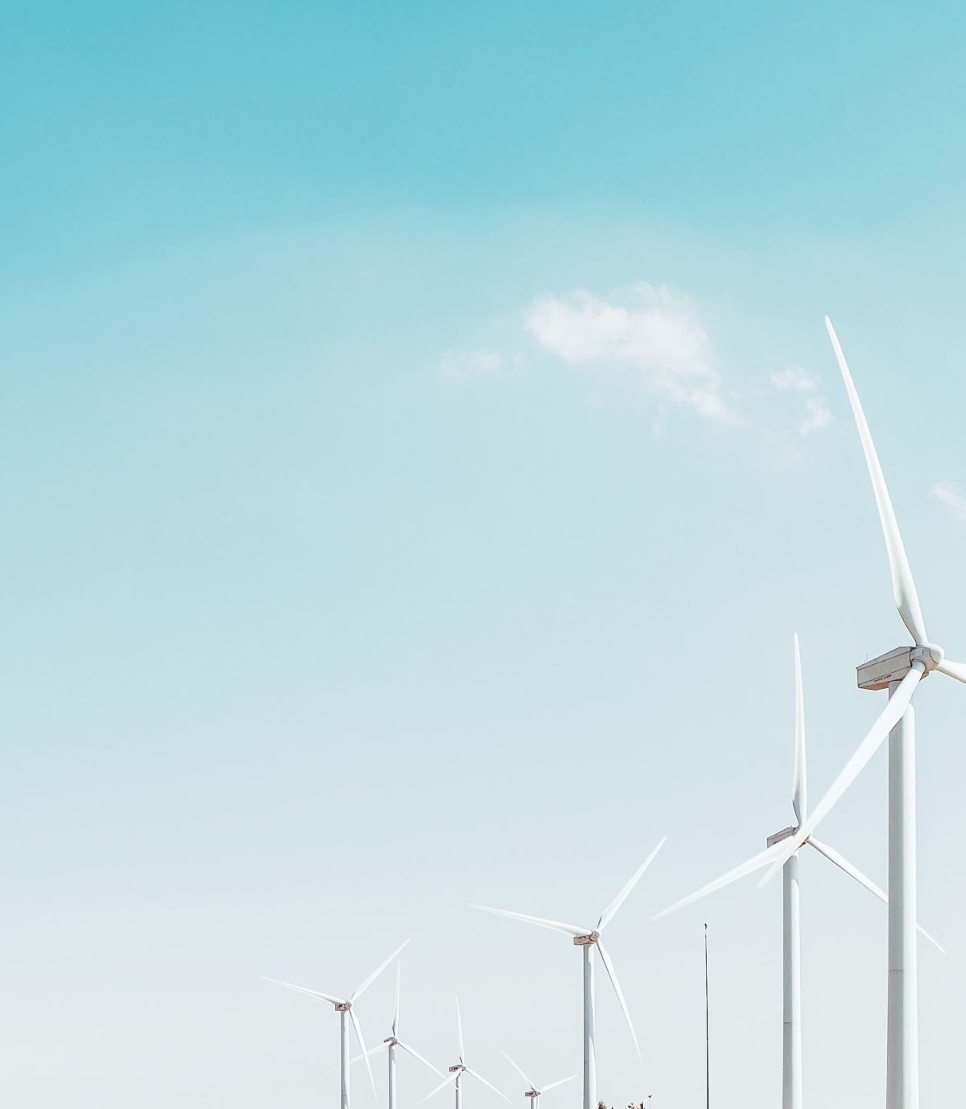
Problem Statement:
The efficiency of solar energy storage devices, like batteries, is still a problem that prevents solar energy from being widely used. How can solar energy be better stored and recovered to increase its dependability and affordability?

Slide 3

AIM: To be more efficient
Efficiency of solar cell 22 –65 °C
But solar cells is efficient up to only 20-30 % of strength
By using our technology we can sustain up to extra more 20%

Slide 4
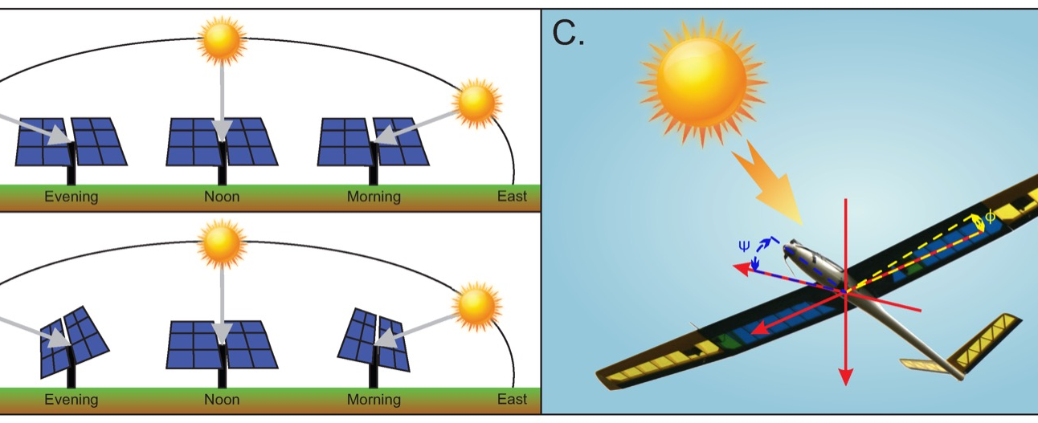
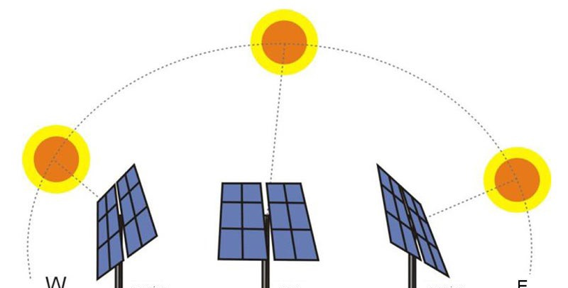
Functioning of AI through sun tracking system :
AI helps figure out where the sun is going to be in the sky throughout the day. This way, solar panels or mirrors can follow the sun for maximum sunlight.
By using AI to follow the sun, solar systems can generate more electricity and save energy.
AI keeps an eye on the sun's current position and makes sure solar panels always point at it, so they capture as much sunlight as possible.
AI also checks the weather and predicts when clouds might cover the sun. It adjusts the solar system in advance to keep things efficient.

Slide 5
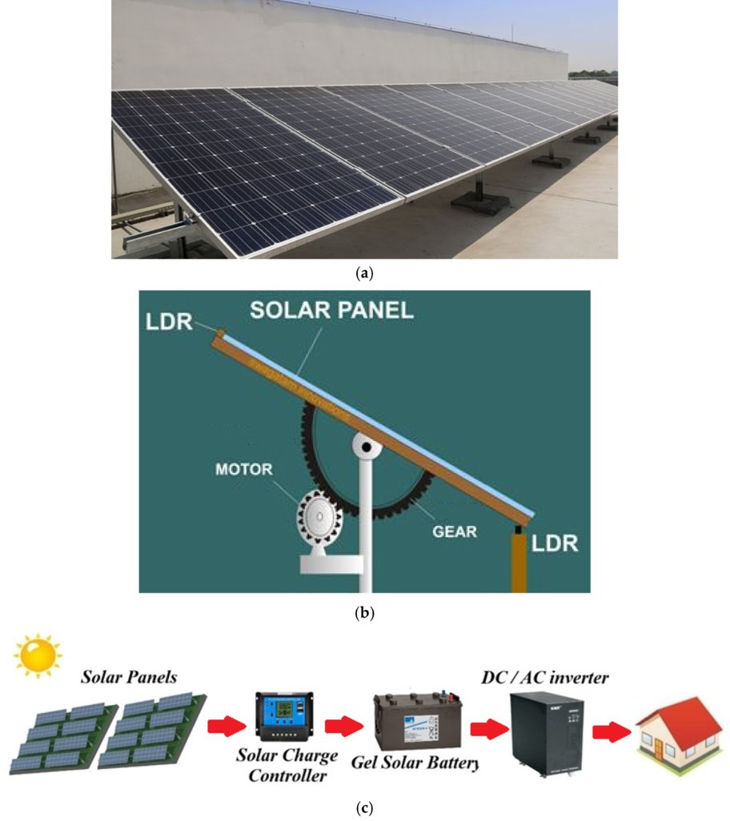
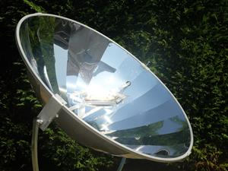

Slide 6
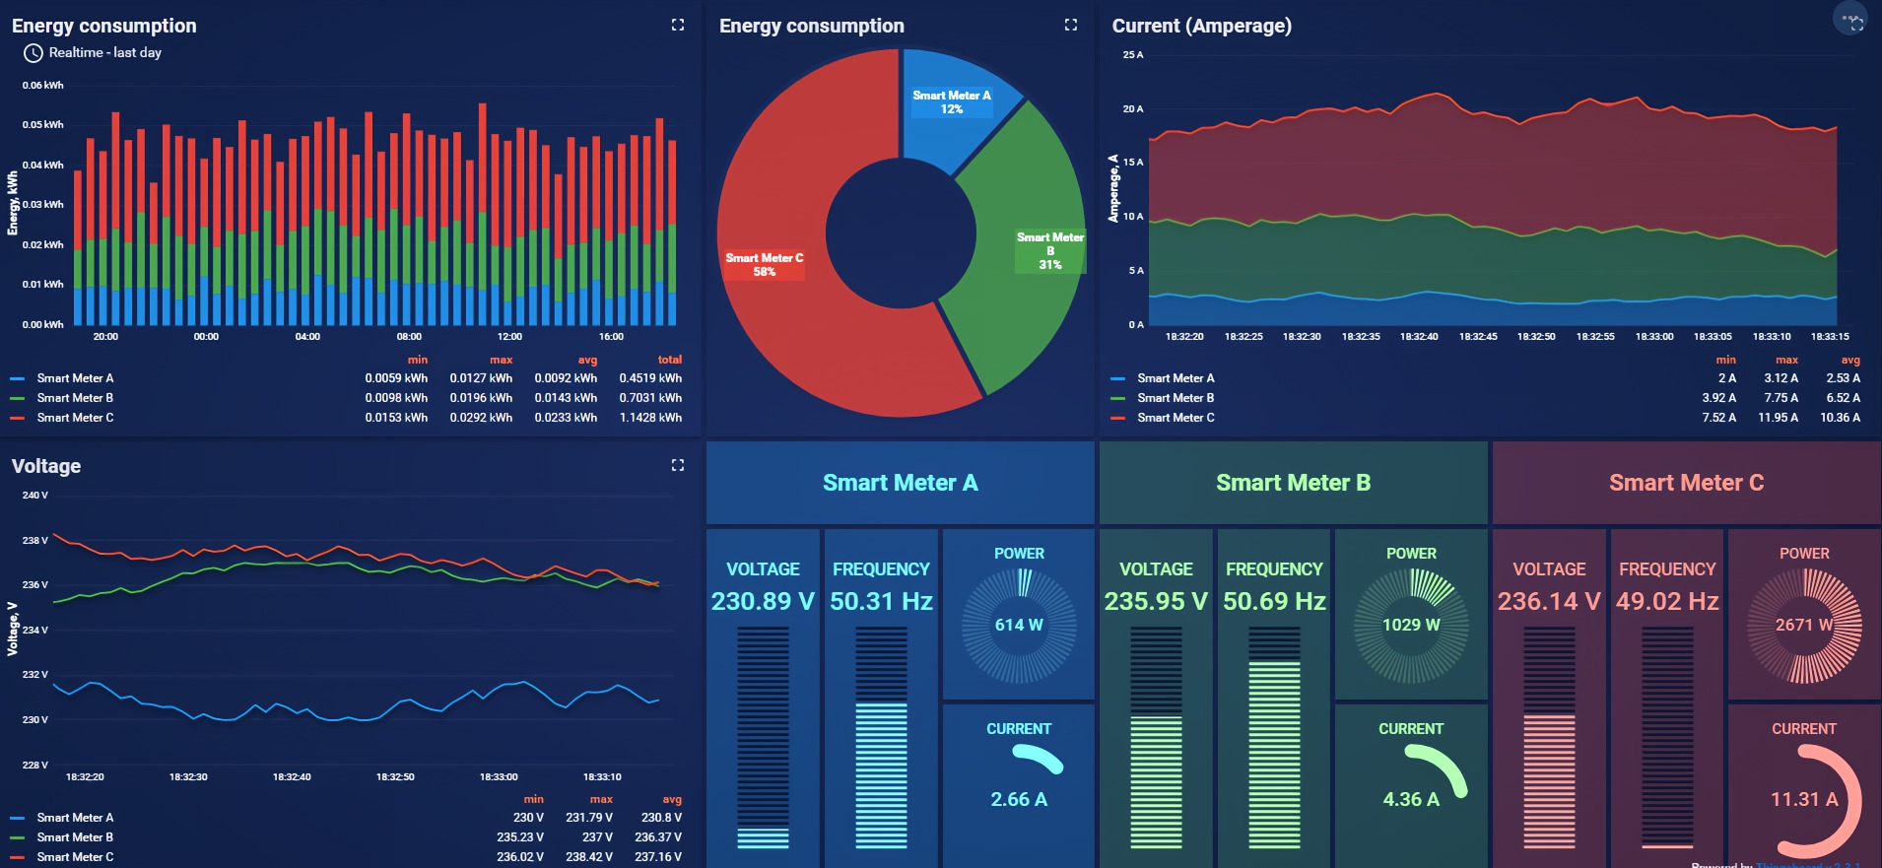

Energy tracker

Slide 7
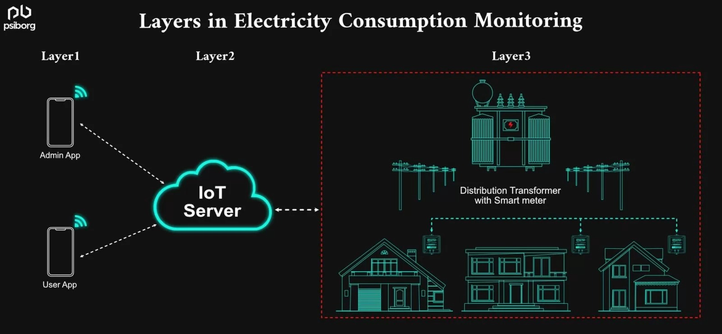

Slide 8

Technology:
Energy Monitoring​
Energy Consumption Analysis:​
Performance Analytics​
Remote Control​
Weather and Forecast Integration​
Maintenance Alerts​
Billing and Payment Integration​
Warranty and Support Information​
Sustainability Tracking​

Slide 9

WEATHER AND FORECAST INTEGRATION

Slide 10
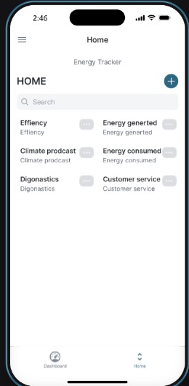
Proto type of app

Slide 11

Investment
Investment in our technology would not require more financial support
But it majorly focuses on the trust gained by the customers who want to maintain their expenses
We can collaborate with the solar industries
Gaining trust from the people is the first and foremost thing

Slide 12

THANK YOU

